Slide 1
Topic 2 Ethical Hacking
ST251Y Ethical Hacking and Defences

Slide 2
Topic 2 : Ethical Hacking
Definition of Hacker
A term to describe of someone who accesses computer systems or networks without authorization
Also known as a cracker
An Ethical Hacker performs most of the same activities but with owner’s permission
Employed by companies to perform penetration tests
Penetration test
Legal attempt to break into a company’s network to find its weakest link

Slide 3
Skill sets of an Ethical Hacker
Hackers typically are skillful computer experts
Script kiddies and packet monkeys
Young inexperienced hackers
Copy codes and techniques from knowledgeable hackers
May not understand the software they are using
What kind of skills does an Ethical Hacker need?

Slide 4
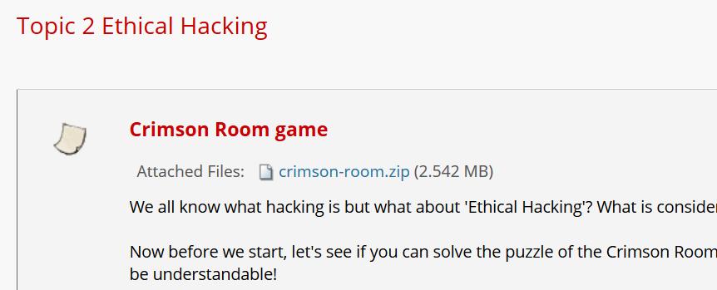
Skill sets of an Ethical Hacker
Play the Crimson Room game if you have not tried it yet
Instructions on how to install it are on BlackBoard

Slide 5

Skill sets of an Ethical Hacker
When you played the Crimson Room game
No instructions were given, you had to figure the game out yourself
You had to search for objects and sometimes the objects were located in obscure places
You had to deduce how to use the objects to open the door

Slide 6
Skill sets of an Ethical Hacker
Sometimes this is what an ethical hacker will face
The only instruction given may be “Make sure the company doesn’t get hacked!”
Have to figure out how to use various technologies to achieve this goal
Let’s look at some IT Security job postings…

Slide 7
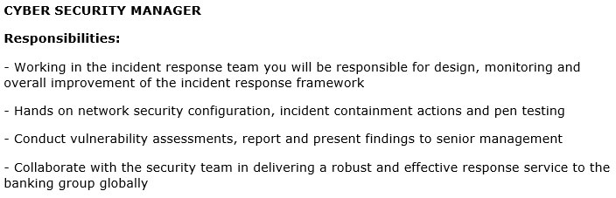
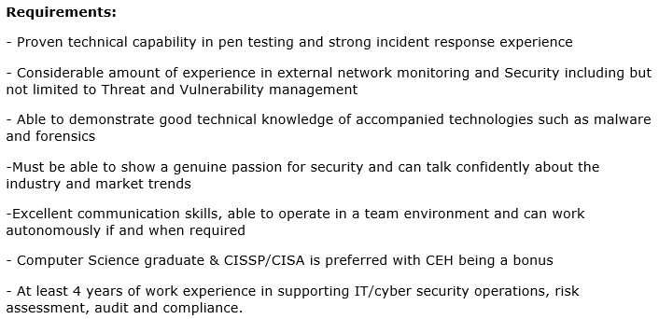
Extract from sg.jobsdb.com

Slide 8
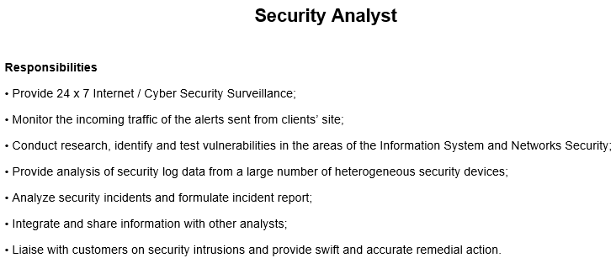
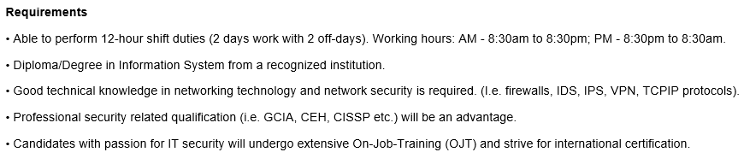
Extract from sp.jobscentral.com.sg

Slide 9
Industry Certifications
Some common IT Security Industry Certifications include
CEH
CISSP
OSCP

Slide 10
Certification Programs for Network and Cyber Security Personnel
Certification programs available in many areas of network infrastructure and cyber security
CompTIA CyberSecurity Analyst (CySA+)
CompTIA Network+
CompTIA Cloud+
Website www.comptia.org

Slide 11
Certified Ethical Hacker (CEH)
Developed by the International Council of Electronic Commerce Consultants (EC-Council)
Based on domains (subject areas)
Cryptography
Footprinting
Scanning, etc
Web site
www.eccouncil.org
Other certifications offered by EC-Council include
Computer Hacking Forensics Investigator (CHFI)

Slide 12
OSSTMM Professional Security Tester (OPST)
Designated by the Institute for Security and Open Methodologies (ISECOM)
Based on the Open Source Security Testing Methodology Manual (OSSTMM)
Written by Peter Herzog
Web site
www.isecom.org

Slide 13
Certified Information Systems Security Professional (CISSP)
Issued by the International Information Systems Security Certifications Consortium (ISC²)
Usually more concerned with policies and procedures
Consists of 8 domains (since Apr 2015 - used to be 10 domains)
Web site
www.isc2.org

Slide 14
Offensive Security Certified Professional (OSCP)
Based on Offensive Security’s course : Penetration Testing with Kali Linux (PwK)
24-hour hands-on exam
https://www.offensive-security.com

Slide 15
Crest Certifications
CREST Practitioner Security Analyst
CREST Registered Penetration Tester
https://www.crest-approved.org/

Slide 16
SANS Institute
SysAdmin, Audit, Network, Security (SANS)
Offers certifications through Global Information Assurance Certification (GIAC)
Resources
Reading Room – documents on cyber security
The Critical Security Controls – Top 20 security controls to protect the organization
And other resources
Web site
www.sans.org

Slide 17
Cyber Security Exercises
Organizations may conduct cyber security exercises to train their IT security personnel
Red team
Typically acts as the attackers
Blue team
Defends the organizations’s networks
Purple team
Work with both red and blue teams, analyzing how each team works, reviewing the results, sharing knowledge

Slide 18
What does a Penetration Tester do?
Perform vulnerability, attack, and penetration assessments in Internet, intranet, and wireless environments
Perform discovery and scanning for open ports and services
Apply appropriate exploits to gain access and expand access as necessary
Participate in activities involving application penetration testing and application source code review
Interact with the client as required throughout the engagement
Produce reports documenting discoveries during the engagement
Debrief with the client at the conclusion of each engagement
Participate in research and provide recommendations for continuous improvement
Participate in knowledge sharing

Slide 19
Penetration-Testing Methodologies
White box model
Tester is told everything about the network topology and technology
Tester is authorized to interview IT personnel and company employees
Makes tester job a little easier
Black box model
Tester is not given details about the network
Burden is on the tester to find these details
Company staff does not know about the security test
Tests if security personnel are able to detect an attack

Slide 20
Penetration-Testing Methodologies
Gray box model
Hybrid of the white and black box models
Company gives tester partial information
Company staff may be informed about the security test to be conducted

Slide 21
Stages of Penetration Testing
Activities in pen-testing can be categorised in different ways
One example : 5 stages of pen-testing
Stage 1 : Information Gathering
Stage 2 : Network Discovery
Stage 3 : Vulnerability Assessment
Stage 4 : Exploiting
Stage 5 : Post-Exploit

Slide 22
Stages of Penetration Testing
Stage 1 : Information Gathering (Footprinting)
Getting information about the target from publicly available sources
Stage 2 : Network Discovery
Discover what’s in the target’s network (usually involve network scanning)
Stage 3 : Vulnerability Assessment
Look for possible vulnerabilities in the network
Some companies may want the pen-tester to stop at Stage 3.

Slide 23
Stages of Penetration Testing
Stage 4 : Exploiting
Test the vulnerabilities if they can be exploited
Test if possible to gain access to the systems, to do denial-of-service attack, etc
Stage 5 : Post-Exploit
May include planting backdoors to ensure persistent access to the systems, covering up tracks, etc

Slide 24
What You Can Do Legally
Laws involving technology change as rapidly as technology itself
Find what is legal for you locally
Laws change from place to place
Be aware of what is allowed and what is not allowed
Some cyber security tools on the tester’s laptop might be illegal to possess in some countries
Contact local law enforcement agencies before installing hacking tools

Slide 25
Laws of the Land
Governments are getting more serious about punishment for cybercrimes
Some examples of cyber criminals caught in Singapore …

Slide 26
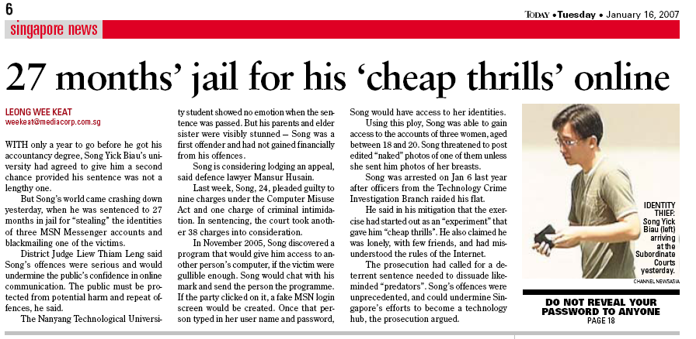
Examples of Hacking Cases

Slide 27
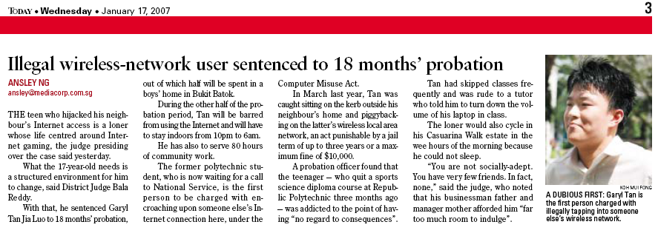
Examples of Hacking Cases

Slide 28
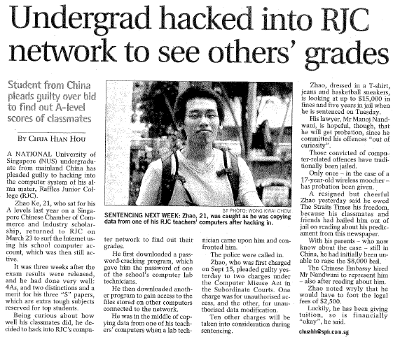
Examples of Hacking Cases

Slide 29
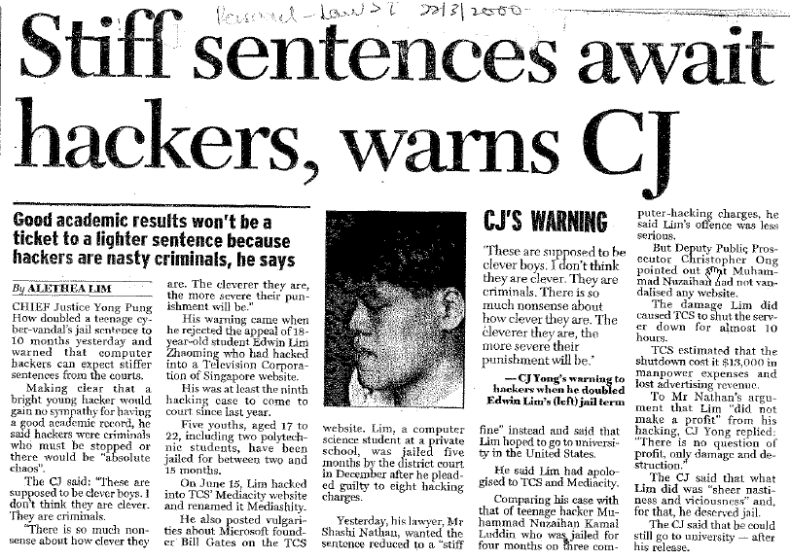
Examples of Hacking Cases

Slide 30

Examples of Hacking Cases

Slide 31
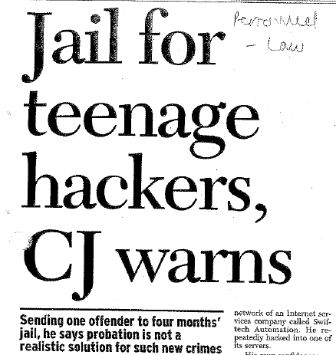
Examples of Hacking Cases

Slide 32
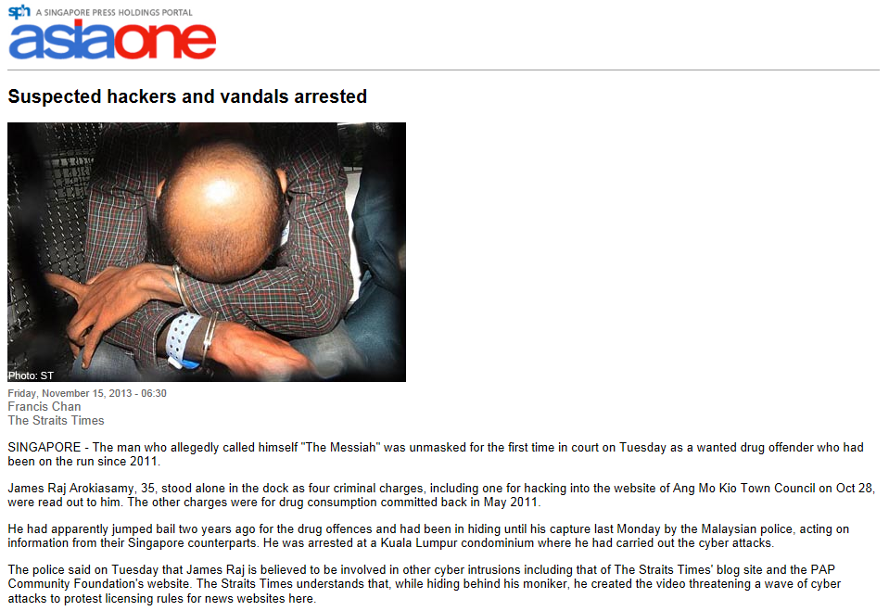

Slide 33
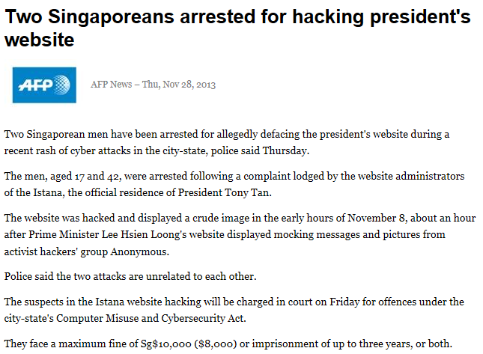

Slide 34
Is Port Scanning Legal?
Some states deem it legal, others say it is illegal
Read this article "Is Unauthorized Port Scanning a Crime?"
https://nmap.org/book/legal-issues.html
Always ensure you have permission to scan the network
Port scanning can generate a high volume of traffic so narrow the scan range to minimize generated traffic
eg if you are looking for web servers, you can scan for Ports 80 and 443 only, instead of all possible ports

Slide 35
Is Port Scanning Legal?
SANS Reading Room : paper on Minimizing Legal Risk When Using Cybersecurity Scanning Tools
https://www.sans.org/reading-room/whitepapers/legal/minimizing-legal-risk-cybersecurity-scanning-tools-37522
IT Consultant arrested and sued for port scanning
https://www.securityfocus.com/news/126

Slide 36
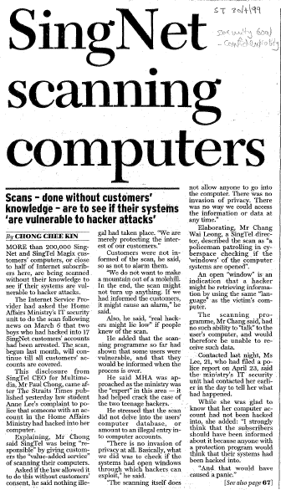

Slide 37
Computer Crime Laws
Computer crime laws are getting more specific
Cover cybercrimes and intellectual property issues
Singapore has its Computer Misuse Act and Cybersecurity Act

Slide 38
Performing the scan / test
Before starting any tests, the penetration tester should discuss with the client on the scope of work
Examples :
Some clients may only want the penetration tester to stop at Stage 3 Vulnerability Assessment, and not go into Stage 4 Exploits
Some clients may only want a subset of their network or computer systems to be tested

Slide 39
Performing the scan / test
The penetration tester has to be careful that any scans or tests that he/she performs on the client’s network and systems do not prevent the client’s staff from doing their jobs
Eg if the scan causes the company network to become slow
The penetration tester may explain to the client the scans or tests he/she is planning and highlight any possible effect on the client’s network and systems
If the network slowdown is unavoidable, the penetration tester may schedule the scan to be run at off-peak times

Slide 40
Get It in Writing
The penetration tester should have a contract from the client
Contracts may be useful in court in case of disputes
Books on working as an independent contractor
The Computer Consultant’s Guide by Janet Ruhl
Getting Started in Computer Consulting by Peter Meyer
Internet can also be a useful resource
Have an attorney read over your contract before sending or signing it

Slide 41
Writing a Penetration Testing Report
After the penetration test is completed, a report has to be written for the client
The report usually contains
Scope of test (eg which systems are tested)
Methodology used (eg black box)
Results of vulnerability assessment (what the tester has found out about the target systems)
Recommendations (how to mitigate any security risks found)

Slide 42
Keep the Penetration Testing Report Secure!
The report will contain sensitive technical information about the client’s network
Network information
Weaknesses found
Such data must be kept confidential
Deliver the report to the client securely

Slide 43
Report templates
There are many examples of penetration testing report templates on the Internet
SANS Reading Room (Paper on Writing a Penetration Testing Report – a copy is on Blackboard)

Slide 44
Ethical Hacking in a Nutshell
What it takes to be a security tester
Knowledge of network and computer technology
Ability to communicate with management and IT personnel
Understanding of the laws
Ability to use necessary tools
Do the Ethical Hacker Quiz on Brightspace (for General Performance marks)

